Slide 1
Retail Sales Prediction
Date: 16-06-2024
Divya.N

Slide 2

Points Of Discussion:
Problem Statement
Objective of the Project
Understanding Dataset
Data Preprocessing
Exploratory Data Analysis
Data Transformation
ML Model Performance
Conclusion
Future work

Slide 3

Problem Statement :
XYZ operates over 3,000 drug stores in 7 countries. XYZ store managers are currently tasked with predicting their daily sales up to six weeks in advance. Store sales are influenced by many factors, including promotions, competition, school, and state holidays, seasonality, and locality. With thousands of individual managers predicting sales based on their unique circumstances, the accuracy of results can be quite varied.
You are provided with historical sales data for 1,115 XYZ stores. The task is to forecast the "Sales" column for the test set. Note that some stores in the dataset were temporarily closed for refurbishment.

Slide 4

Objective:
The main objective of this project is to develop a predictive model that can accurately forecast daily sales for a retail store chain. This involves utilizing historical sales data and various influencing factors to predict future sales, which can aid store managers in making informed business decisions.
The key goals are:
Improve Sales Forecast Accuracy
Optimize inventory management
Enhance promotional planning
Resource Allocation
Support strategic decision making
Account for variability

Slide 5

Understanding The Data:
Data Description:
Sales Data.csv – Historical data including Sales
Store Data.csv – Supplemental information about the store
{After merging both the datasets we have 1017209 number of records and 18 number of fields and our dataset period is from 1st jan-2013 to 31st July-2015.}
Data Fields:
Most of the fields are self-explonatory. The following are the description
for those that aren’t.
Id - an Id that represents a (Store, Date) duple within the set
Store - a unique Id for each store
Sales - the turnover for any given day (Dependent Variable)
Customers - the number of customers on a given day
Open - an indicator for whether the store was open: 0 = closed, 1 = open
State Holiday - indicates a state holiday. Normally all stores, with few exceptions, are closed on state holidays. Note that all schools are closed on public holidays and weekends. a = public holiday, b = Easter holiday, c = Christmas, 0 = None
School Holiday - indicates if the (Store) was affected by the closure of public schools.

Slide 6

Store Type - differentiates between 4 different store models: a, b, c, d
Assortment - describes an assortment level: a = basic, b = extra, c = extended. An assortment strategy in retailing involves the number and type of products that stores display for purchase by consumers.
Competition Distance – the distance in meters to the nearest competitor store
Competition Open Since[Month/Year] - gives the approximate year and month of the time the nearest competitor was opened
Promo - indicates whether a store is running a promo on that day
Promo2 - Promo2 is a continuing and consecutive promotion for some stores: 0 = store is not participating, 1 = store is participating
Promo2 Since[Year/Week] - describes the year and calendar week when the store started participating in Promo2
Promo Interval - describes the consecutive intervals Promo2 is started, naming the months the promotion is started anew. E.g. "Feb, May, Aug, Nov" means each round starts in February, May, August, and November of any given year for that store.

Slide 7
Data Pre- Processing :
Data Wrangling and processing requires cleaning of data and preparing it for further analysis. Our cleaning process involve the following parts:
Merge both the dataset : We have merge both the available dataset.
Data extraction : We have extracted Date, Year, Month, Day, Week, Week of Year from date column for further analysis and then dropped the date column.
Null Value treatment: I have dropped Promo2SinceWeek, Promo2SinceYear, PromoInterval , CompetitionOpenSinceMonth, CompetitionOpenSinceYear from the store data as they contains more null values.
CompetitionDistance column contains few missing values and I have filled with Median.
Outlier Treatment: This data set contains more null values in Sales, Customers, and CompetitionDistance but CompetitionDistance contains more null values:
We find the percentile values (90,95,99) for the three columns which contains outliers and we considered
around 95%
Conversion: We converted state_holiday column which we haves values a, b, c as ‘1’ and remaining values ‘0’. And dropped the StateHoliday column. I have converted data type of competitionDistance from float to int.

Slide 8
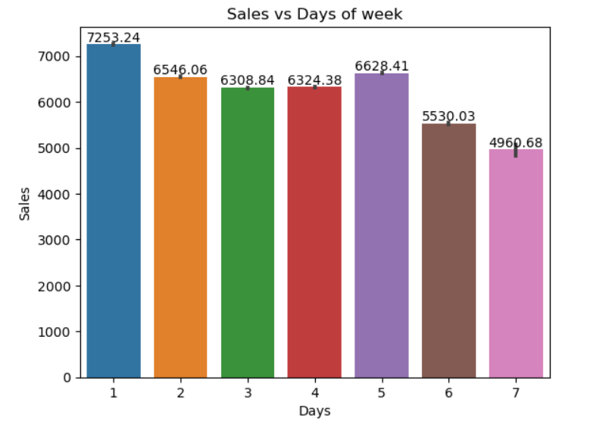
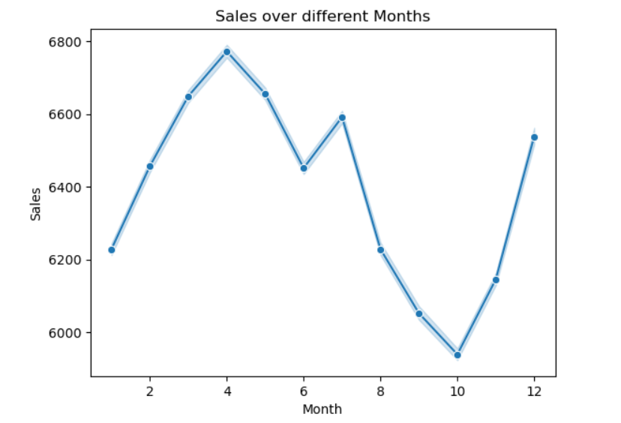
Data Visualization:
Sales Vs Days of week:
I have used seaborn bar plot to find out the sales over week days
It has been find out that Day-1 i.e. Monday has got maximum Sales and Day-7 i.e. Sunday has got least
From the bar plot it can been seen that after day1-1 there has been decline in the sales. sufficient measures should be taken to look into this matter
Sales Over Different Months:
I have Picked line plot to show sales over month trend
it can been seen that after October there has a growth in sales that might be due to festival season. December shows maximum sales may be because of Christmas and new year.
From the plot it can be seen that sales has been dropped in the month of may so the management needs to focus on this and they can also run any promo to increase the sales

Slide 9
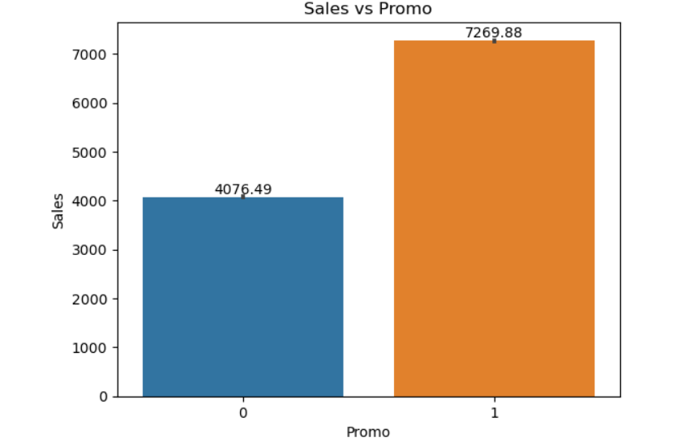
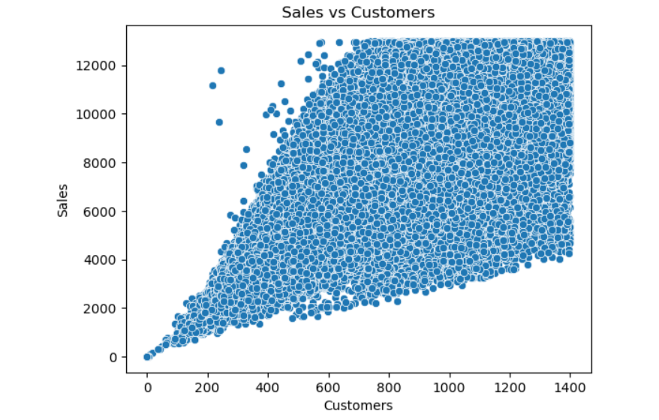
Data Visualization:
Sales Vs Promo:
I have used bar plot to find out the relationship between sales and promo.
It has been find out that the sales get's almost double when a promo is running.
Business should try to run more promo in order to get more sales and particularly when on those days where sales are minimum
Sales Vs Customers:
I have used scatter plot to find out the relationship between customers and sales.
It was find out from the plot that the customers and sales are positively corelated to each other i.e. more customer visits the store more will be sales
Management should always try to always focus to attract more and more customers in order to increase Sales

Slide 10
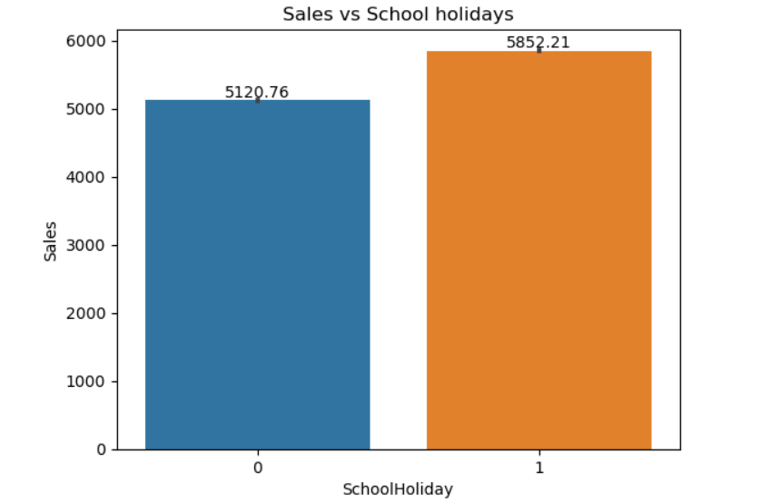
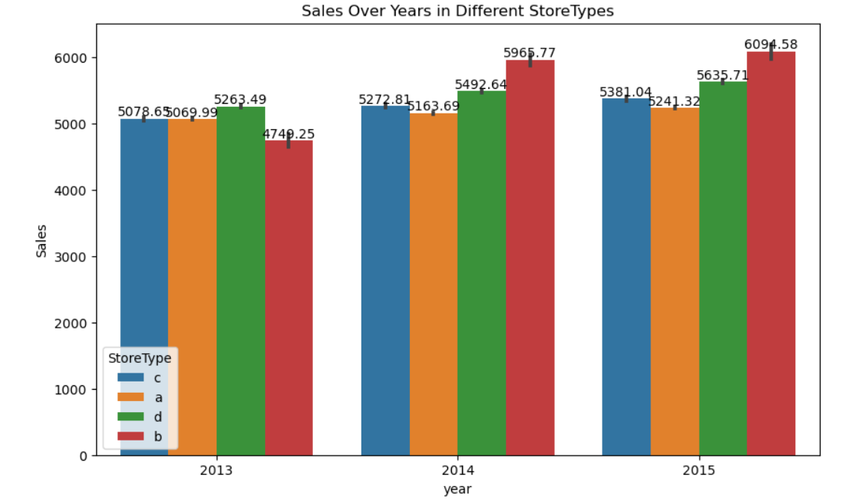
Data Visualization:
Sales Vs School Holiday:
I have picked bar plot to find out the effect of SchoolHoliday on Sales
From the graph it can be seen that there is a very good sales when schoolholiday is there, also good sales can be seen when there is no school Holiday, so SchoolHoliday doesn't really affect the sales
Since there is very small difference in sales and sales are maximum during school holidays. So the management needs to consider this also to increase sales during
Sales Over Year in Different store types:
I have picked bar plot to find out Sales over year in different Store types
It was find out that Store b sales has been increased from 2013 to 2015 and in 2013 store d has maximum sales and in remaining years store b has maximum sales
The graph shows that the sales in b store type has increased over all years but sales in other store types remained almost same. So, other store should also try to use same business statics as of store b

Slide 11
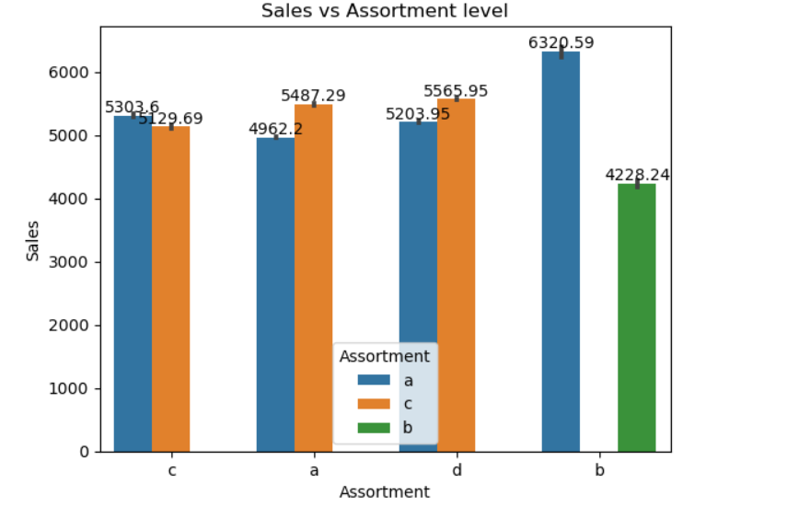
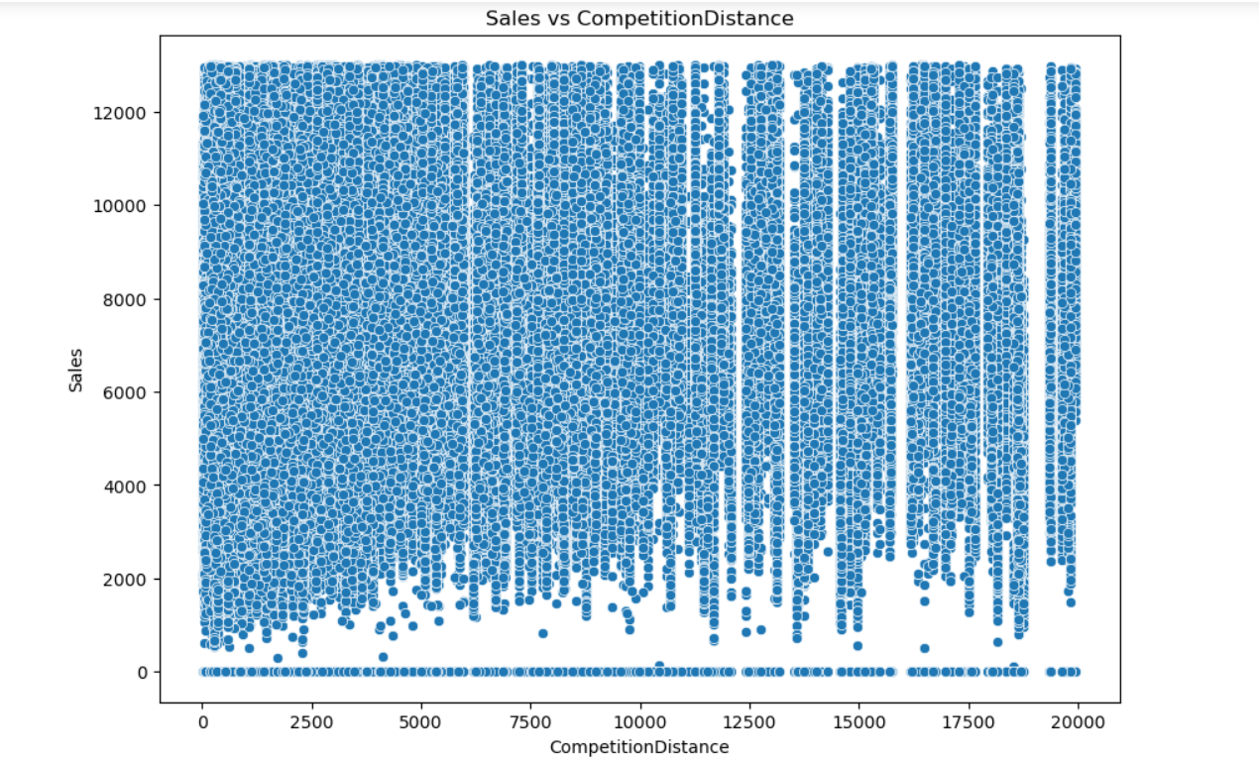
Data Visualization:
Sales Vs Assortment level:
I have picked bar plot to visualize the sales in different store types with different assortment levels
From the plot it can that in Store B only a and b assortment has been used and out of which assortment a got maximum sales Also in remaining Store only a and c assortment level has been and they got equal sales
from the graph it can be seen there was no store were all type of assortment level were used so management should try to use all type of assortment levels
Sales Vs Competition Distance:
I have used scatter plot to find out the relationship between Sales and Competition Distance
It can been seen that most of the stores are very densely located to each other have more sales
Since there is very high competition so in order to keep growing the store owner need to run attracting offers to attracts more customers and increase the sales

Slide 12
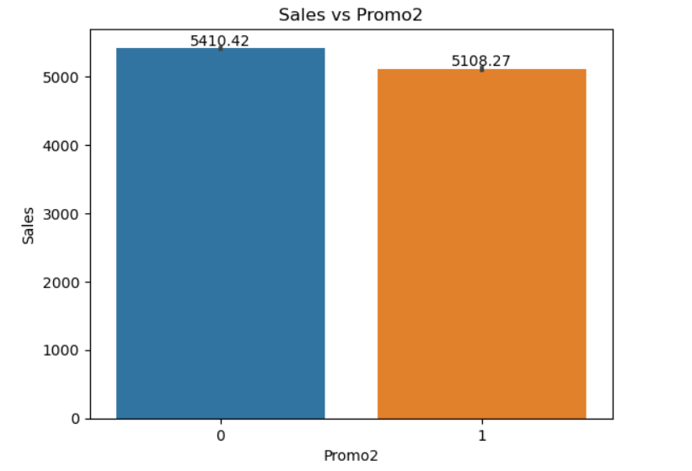
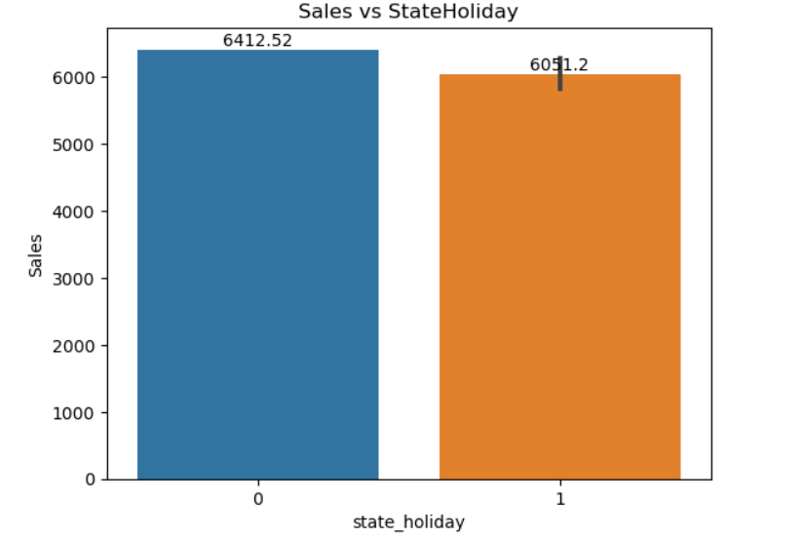
Data Visualization:
Sales Vs Promo2:
I have used bar plot to find out effect of promo 2 on sales
It can be seen from the graph that Running promo continuously has not been that much effective towards increasing Sales
As running Promo Continuously promo has not been that much effective towards sales so management either needs to drop this offer or to run it in more effective way
Sales Vs State Holiday:
I have picked bar plot to find out the effect of any type of state holiday on sales by how much
From the bar plot it can be easily seen that it doesn't matter whether there is state holiday or not there is good amount of sales on both the occasions and from the pie chart it can be seen that only 3% of sales is effected by stateholiday. So overall sales doesn't depend on stateholiday
The stateholiday doesn't effects sales

Slide 13
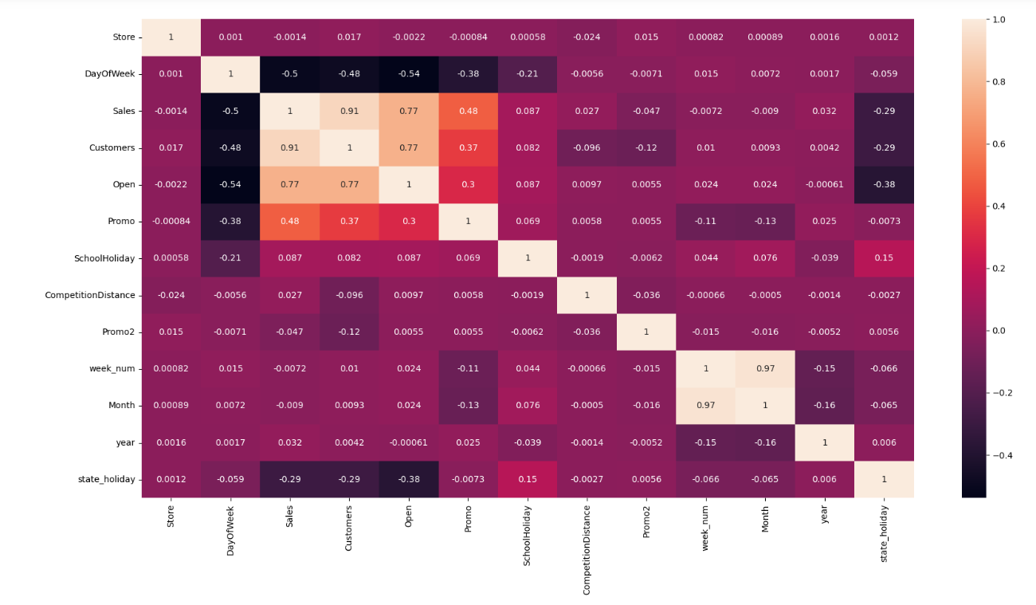
Data Visualization:
Correlation Heatmap:
I have Picked the heatmap to find out the correlation of all features with each other
It can be find out that Promo, Open and customer has positive correlation with Sales means that if the shop is running any promo more customers will visit the store there will be more sales
Day of week is in negative correlation with sales that means on weekends Store will be closed, there will be no sales and competition distance also some negative correlation.
State holiday has very low negative correlation with sales as sales is not affected by state holiday same case with the school holiday
Multicollinearity lies between promo, customers and open column

Slide 14

Data Transformation, Data Scaling and Data Splitting:
Handling Zero Sales:
Some sales values are zero because the shop was closed for refurbishment.
Skewness in Features:
Positive skewness is present in the Customers and CompetitionDistance features.
Applied square root transformation to correct the right skewness of these features.
Data Scaling:
Used StandardScaler from scikit-learn to scale the data.
This scaling method transforms data to have a mean of 0 and a standard deviation of 1.
Train-Test Split:
Chose an 80-20 split for the dataset.
Allocated 80% of the data to the training set to capture enough patterns and relationships for model training.
ML Model Selection:
Implement multiple machine learning algorithms, including linear regression, decision trees, random forest and XGBoost with regression techniques
Evaluated model performance using metrics such as R-squared score, means square error, and root mean square error

Slide 15
Model Performance:
Comparison of Models: Table for comparing the performance metrics of different models.
S.no | Regressions | MSE(Mean squared error) |  | RMSE(Root mean Squared error) |  | R2(Root Squared)
 |  | Train Score | Test Score | Train Score | Test Score | Train Score | Test Score
1. | Linear Regression | 37.9 | 37.8 | 6.13 | 6.14 | 0.81 | 0.81
2. | Lasso Regression | 37.6 | 37.8 | 6.13 | 6.14 | 0.81 | 0.81
3. | Ridge Regression | 37.7 | 37.9 | 6.14 | 6.15 | 0.81 | 0.81
4. | Decision Tree Regressor | 7.5 | 12.08 | 2.8 | 3.47 | 0.96 | 0.94
5. | XG Boost Regressor | 5.46 | 8.9 | 2.31 | 2.9 | 0.97 | 0.95
6. | Random Forest Regressor | 3.63 | 8.9 | 1.90 | 2.9 | 0.98 | 0.96
After performing various regression techniques on our predictive model and we found out that XGBoost Regression and Random Forest Regression has performed better than any other regression model with 95% and 96% respectively.

Slide 16
Conclusion:
EDA Conclusion:
Sales are influenced by the day of the week, promotional activities, customer visits, store location density, and assortment types.
Sales are relatively unaffected by school holidays and state holidays.
December shows significant sales boosts due to the festive period.
Store B has shown consistent growth and dominance in sales from 2013 to 2015.
Continuous promotions have a limited long-term impact on increasing sales.
ML Model conclusion:
The Random forest model was chosen as the final prediction model due to its superior performance.
Configured with learning rate of 0.1,max depth of 15, and 100 estimators
Achieved an R2 score of approximately 98% on the training data and 96% on the test data
Recorded the lowest Mean Squared Error (MSE) of 8.9
Recorded the lowest Root Mean Squared Error (RMSE) of 2.9

Slide 17

Future work:
1.Incorporate Time-Series Features:
Enhance the model by integrating time-series specific features, such as lagged variables, moving averages, and seasonal decomposition. This can help the model better capture temporal patterns and improve prediction accuracy.
2.Model Deployment and Monitoring:
Develop and deploy the model for real-time sales predictions using a cloud-based platform. Implement a continuous monitoring system to track model performance over time and retrain the model as necessary to maintain its accuracy and reliability.

Slide 18


